Slide 1
Advanced Modeling for Distribution Planning with OpenDSS
Instructor
Roger C. Dugan Sr. Technical Executive Sacramento, California June 22-23, 2017

Slide 2

Instructor
Roger C. Dugan, Life Fellow, IEEE
Roger is a Sr. Technical Executive with EPRI in Knoxville, Tennessee USA. He has over 45 years of combined experience in distribution engineering with EPRI, Electrotek Concepts, and Cooper Power Systems. He holds the BSEE degree from Ohio University and the Master of Engineering in Electric Power Engineering degree from Rensselaer Polytechnic Institute, Troy, NY. Roger has worked on many diverse aspects of power engineering over his career because of his interests in applying computer methods to power system simulation. Beginning with a student internship with Columbus and Southern Ohio Electric Co, his work has been focused on Distribution Engineering. He was elected a Fellow of the IEEE for his contributions in harmonics and transients analysis. Recently, he has been very active in distributed generation, particularly as it applies to utility distribution systems and distribution system analysis. He was the 2005 recipient of the IEEE Excellence in Distribution Engineering Award. He is coauthor of Electrical Power Systems Quality published by McGraw-Hill, now in its 3rd edition. He serves on the IEEE PES Distribution System Analysis Subcommittee and is active in the Distribution Test Feeders WG.

Slide 3
Application Programming Interfaces (API)
COM Interface and DirectDLL Interface

Slide 4
DSS Structure
Scripts
Main Simulation Engine
COM Interface
User-Written DLLs
Scripts, Results

Slide 5
Why You Might Want to Write Some Code …
There is no looping in the DSS scripting language
To implement an algorithm not in OpenDSS
For optimizing device siting …
Generators
Capacitors
Reclosers
To automate some repetitive analysis task
To develop a new device model or control
Using the COM interface
Writing a Dynamic-Linked Library (DLL)

Slide 6
Ways to Write Code to Do Innovative Things with OpenDSS
COM Interface
Microsoft standard: Windows only
Well supported in MS Office as well as Python and other languages
DirectDLL Interface
Standard function call library
Same functions as COM interface, but for languages that do not support COM
Write a separate program to auto-generate DSS scripting code and run as text script

Slide 7
What Languages Can You use for Your Code?
Excel VBA
VB.net
C#
C/C++
Delphi, Free Pascal
MATLAB
Python
Java
LabView
R
Fortran (for DLLs, with DirectDLL)
Julia (with DirectDLL)

Slide 8
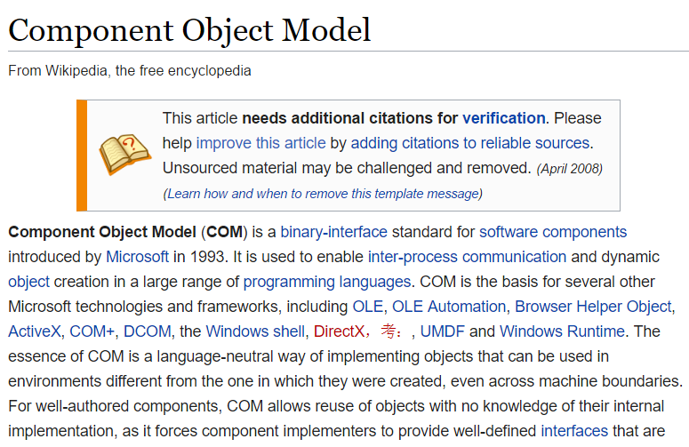
COM Interface

Slide 9
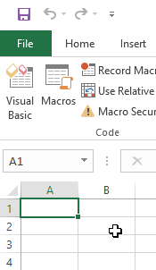
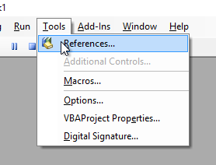
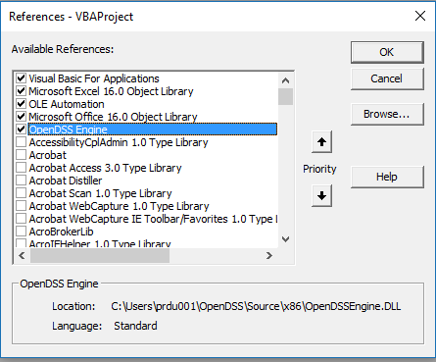
Finding COM Servers on Your Computer
Excel VBA

Slide 10
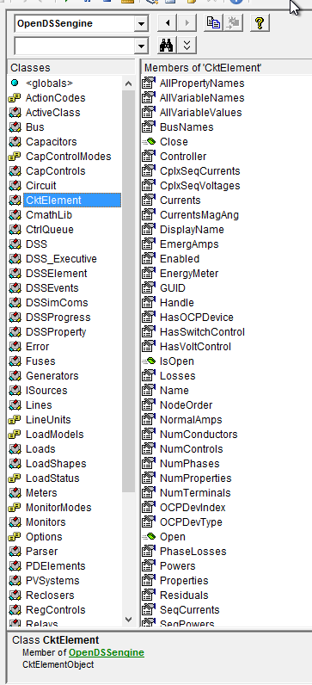
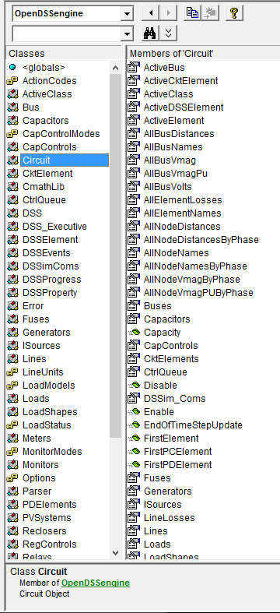
Object Browser in VBA for OpenDSSEngine
The Object Browser in MS Office VBA is a good way to learn what is available through the OpenDSS COM Interface

Slide 11
(Demonstration of Using the COM Interface in Excel VBA)

Slide 12
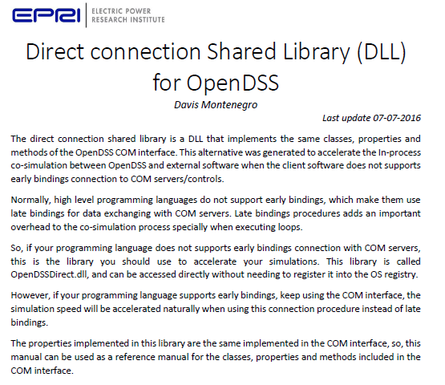

Slide 13
DirectDLL Exports
exports
DSSPut_Command,
DSSLoads, DSSLoadsF,DSSLoadsS, DSSLoadsV,
DSSProperties,
CktElementI, CktElementF, CktElementS, CktElementV,
ErrorCode, ErrorDesc,
CircuitI, CircuitF, CircuitS, CircuitV,
BusI, BusF, BusS, BusV,
SolutionI, SolutionF, SolutionS, SolutionV,
MonitorsI, MonitorsS,MonitorsV,
MetersI,MetersF,MetersS,MetersV,
GeneratorsI,GeneratorsF,GeneratorsS,GeneratorsV,
DSSProgressI,DSSProgressS,
SettingsI,SettingsF,SettingsS,SettingsV,
LinesI, LinesF, LinesS, LinesV,
CtrlQueueI,CtrlQueueV,
DSSElementI, DSSElementS, DSSElementV,
ActiveClassI, ActiveClassS, ActiveClassV,
CapacitorsI,CapacitorsF,CapacitorsS,CapacitorsV,
TransformersI,TransformersF,TransformersS,TransformersV,
SwtControlsI,SwtControlsF,SwtControlsS,SwtControlsV,
CapControlsI,CapControlsF,CapControlsS,CapControlsV,
RegControlsI,RegControlsF,RegControlsS,RegControlsV,
TopologyI,TopologyS,TopologyV,
DSSExecutiveI,DSSExecutiveS,
SensorsI,SensorsF,SensorsS,SensorsV,
XYCurvesI,XYCurvesF,XYCurvesS,XYCurvesV,
PDElementsI,PDElementsF,PDElementsS,
ReclosersI, ReclosersF, ReclosersS, ReclosersV,
RelaysI,RelaysS,RelaysV,
CmathLibF,CmathLibV,
ParserI,ParserF,ParserS,ParserV,
LoadShapeI,LoadShapeF,LoadShapeS,LoadShapeV,
FusesI,FusesF,FusesS,FusesV,
IsourceI,IsourceF,IsourceS,IsourceV,
PVsystemsI,PVsystemsF,PVsystemsS,PVsystemsV,
VsourcesI,VsourcesF,VsourcesS,VsourcesV,
DSSI,DSSS,DSSV,
InitAndGetYparams,GetCompressedYMatrix,ZeroInjCurr,GetSourceInjCurrents,GetPCInjCurr,
SystemYChanged,BuildYMatrixD,UseAuxCurrents,AddInAuxCurrents,getIpointer,
getVpointer,SolveSystem;

Slide 14
Example: Circuit Interface in Direct DLL
For each COM Interface there is a series of functions:
function CircuitI(mode:longint; arg: longint):longint;cdecl;
function CircuitF(mode:longint; arg1, arg2: double):double;cdecl;
function CircuitS(mode:longint; arg: pAnsiChar):pAnsiChar;cdecl;
procedure CircuitV(mode:longint; out arg:variant; arg2: longint);cdecl;
…I – Returns Integer values
…F – Returns Floating-Point Values (64 bit)
…S – Returns long pointer to ANSI string
…V – Returns Variant values (arrays, complex numbers, etc.)
Mode – Specifies which quantity you want from the Circuit interface (see doc)
The OpenDSS DirectDLL is documented in
…\doc\OpenDSS_Direct_DLL.pdf

Slide 15
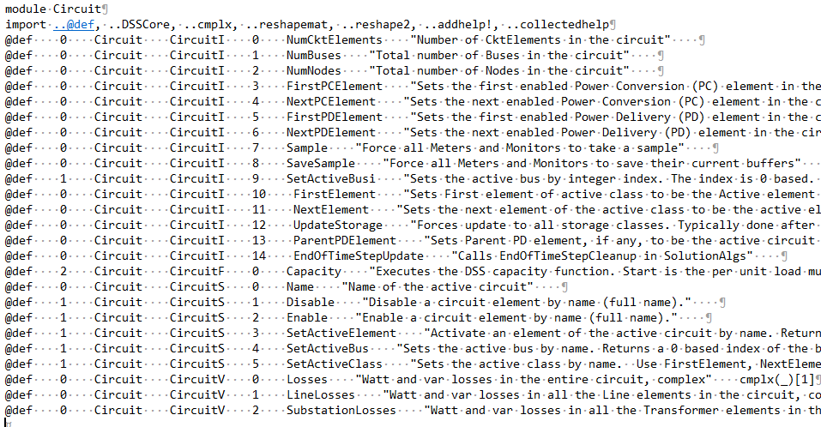
Example: Redefining the DirectDLL Functions for Julia

Slide 16
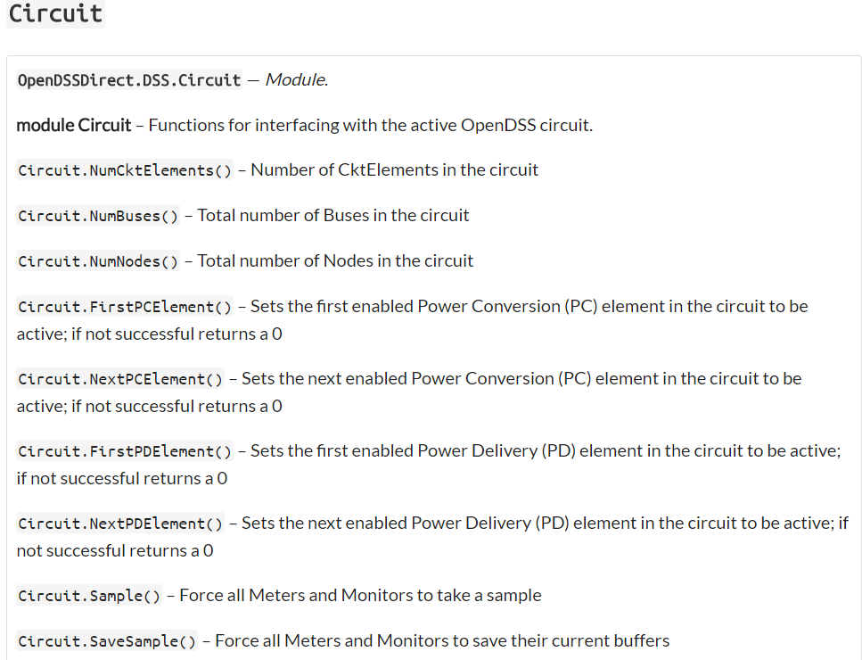
Resulting Circuit Interface in Julia

Slide 17
References to DirectDLL Usage via Julia
https://tshort.github.io/OpenDSSDirect.jl/stable/api.html
https://github.com/tshort/OpenDSSDirect.jl/tree/master/examples
https://github.com/tshort/OpenDSSDirect.jl/tree/75ec31703fc44035d9f617775f21def2489a3a07
https://github.com/tshort/OpenDSSDirect.jl/blob/75ec31703fc44035d9f617775f21def2489a3a07/src/api.jl#L1278
(From Tom Short’s github site)

Slide 18
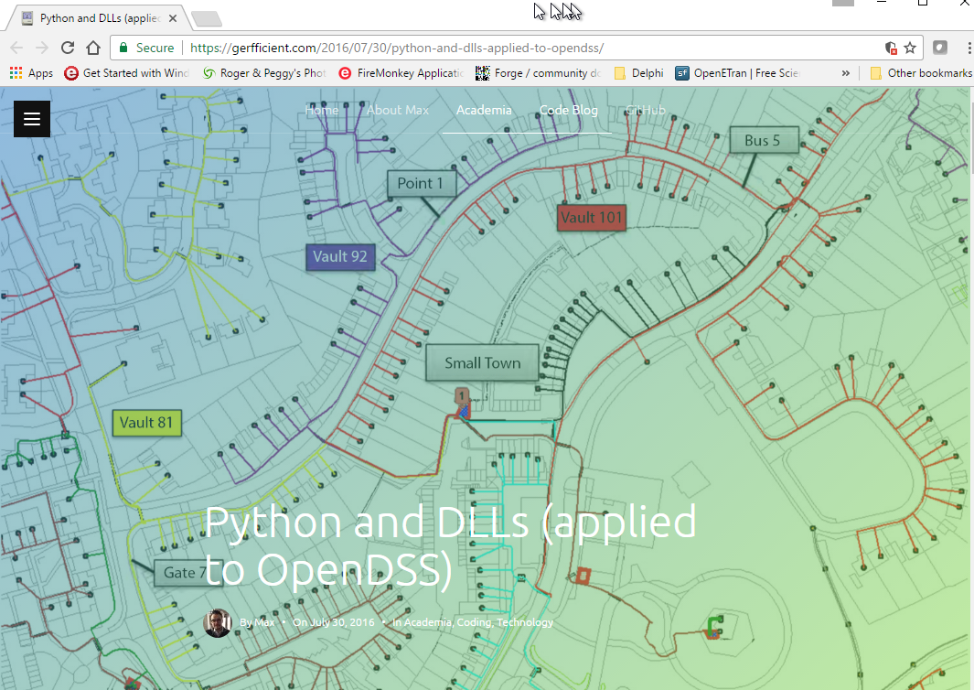
An Interesting 3rd Party Link Using the Direct DLL interface

